Slide 1
Class Content:
Decision Tree Pruning
Pre-Pruning in Decision Tree
Post-Pruning in Decision Tree
Ensemble Machine Learning
Bagging Algorithms
Boosting Algorithms
Random Forest In-depth
Hyper Parameter Tuning using:
Randomized Search CV
Grid Search CV
Python Implementations

Slide 2
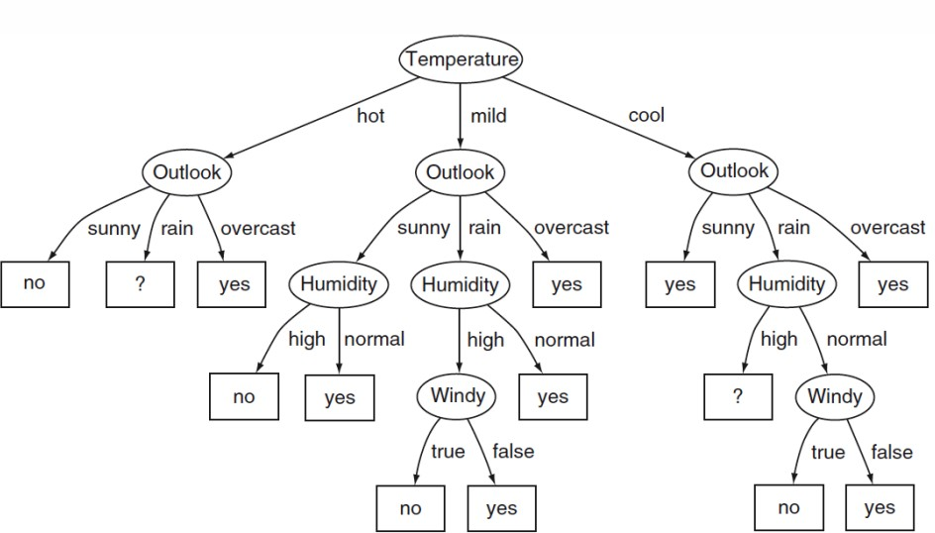
Decision Tree

Slide 3
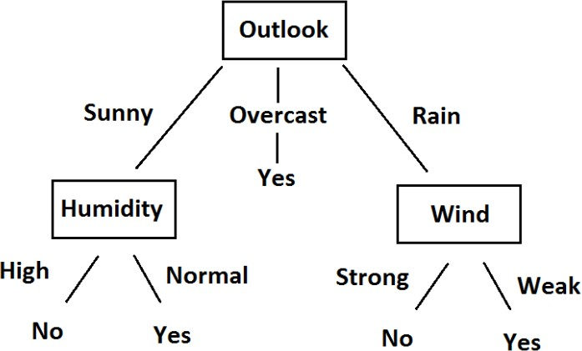
Pruning in Decision Tree
Normal Decision Tree
After Post Pruning
Tree - 01
Tree - 02
Temperature
Outlook
Humidity

Slide 4
Pre-Pruning vs Post-Pruning
Pruning is of two types:
Post Pruning(Backward Pruning): Full tree is generated and then the non- significant branches are pruned/removed. Cross validation is performed at every step to check whether addition of the new branch leads to increase in accuracy. If not the branch is converted to leaf node.
Pre Pruning(Forward Pruning): This approach stops the non-significant branches from generating. It terminates the generation of new branch based on the given condition.

Slide 5
Ensemble Methods in Machine Learning
Bagging or Bootstrap Aggregation
Bagged Decision Trees
Random Forest Classifier or Regressor
Extra Trees
Boosting
AdaBoost
Gradient Boosting
XGBoost

Slide 6
Ensemble Methods in Machine Learning
Bagging. Building multiple models (typically of the same type) from different
subsamples of the training dataset.
Boosting. Building multiple models (typically of the same type) each of which learns to fix the prediction errors of a prior model in the chain.

Slide 7
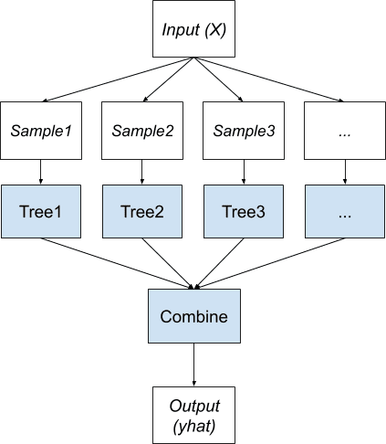
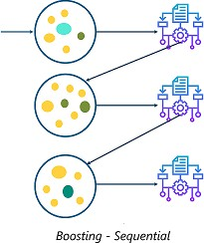
Ensemble Algorithm in Machine Learning
Ensemble learning refers to algorithms that combine the predictions from two or more models. Although there is nearly an unlimited number of ways that this can be achieved, there are perhaps two classes of ensemble learning techniques that are most commonly discussed and used in practice. Bagging & Boosting.

Slide 8
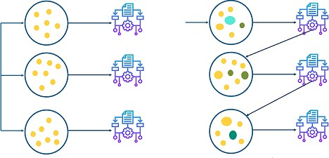
Ensemble Methods in Machine Learning
Bagging
VS
Boosting
Bagging - Parallel
Boosting - Sequential

Slide 9
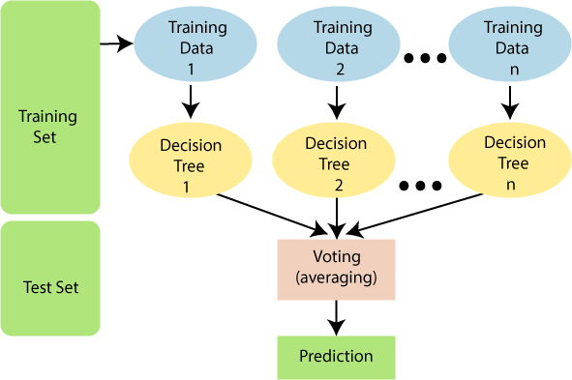
Random Forest
Random forests or random decision forests is an ensemble learning method for classification, regression and other tasks that operates by constructing a multitude of decision trees at training time. For classification tasks, the output of the random forest is the class selected by most trees.
Random Forest is a classifier that contains a number of decision trees on various subsets of the given dataset and takes the average to improve the predictive accuracy of that dataset. Instead of relying on one decision tree, the random forest takes the prediction from each tree and based on the majority votes of predictions, and it predicts the final output. The greater number of trees in the forest leads to higher accuracy and prevents the problem of overfitting.
Creating base learners models

Slide 10
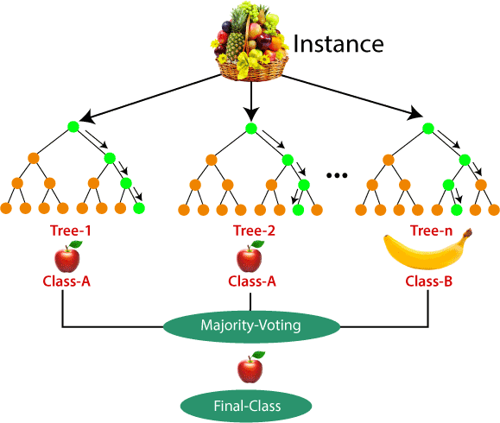
Random Forest
Steps involved in random forest algorithm:
Step 1: In Random forest n number of random records are taken from the data set having k number of records.
Step 2: Individual decision trees are constructed for each sample.
Step 3: Each decision tree will generate an output.
Step 4: Final output is considered based on Majority Voting or Averaging for Classification and regression respectively.
For example: consider the fruit basket as the data as shown in the figure below. Now n number of samples are taken from the fruit basket and an individual decision tree is constructed for each sample. Each decision tree will generate an output as shown in the figure. The final output is considered based on majority voting. In the below figure you can see that the majority decision tree gives output as an apple when compared to a banana, so the final output is taken as an apple.

Slide 11
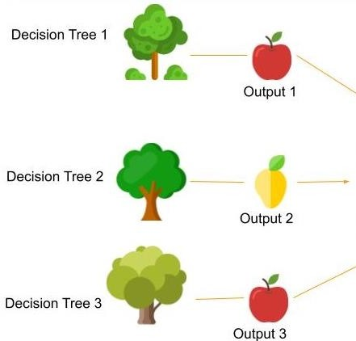


Random Forest
How Random Forest Works
with a Simple Visualization
Base Learners Model
Row Sampling
Feature Sampling
Majority Voting
Data set
Row Sampling
Feature Sampling
Data set
Final Output
DT-1
DT-2
…...
DT-N

Slide 12
Random Forest
Real-Time Use cases:
Random Forest has been the go-to Model for Price Prediction, Fraud Detection in Financial statements, Various Research papers published in these areas recommend Random Forest as the best accuracy producing model.
Random Forest Model has proved to provide good accuracy in predicting disease based on the features.
Moreover, a random forest technique has the capability to focus both on observations and variables of training data for developing individual decision trees and take maximum voting for classification and the total average for regression problems respectively. It also uses a bagging technique that takes observations in a random manner and selects all columns which are incapable of representing significant variables at the root for all decision trees. In this manner, a random forest makes trees only which are dependent on each other by penalizing accuracy. We have a thumb rule which can be implemented for selecting sub-samples from observations using random forest. If we consider 2/3 of observations for training data and p be the number of columns then

Slide 13
Random Forest
Classifier Vs Regressor
A random forest classifier works with data having discrete labels or better known as class. Example- A patient is suffering from cancer or not, a person is eligible for a loan or not, etc.
A random forest regressor works with data having a numeric or continuous output and they cannot be defined by classes. Example- the price of houses, milk production of cows, the gross income of companies, etc.

Slide 14
Random Forest
Advantages and Disadvantages of Random Forest
It reduces overfitting in decision trees and helps to improve the accuracy
It is flexible to both classification and regression problems.
It works well with both categorical and continuous values
It automates missing values present in the data
Normalizing of data is not required as it uses a rule-based approach.
However, despite these advantages, a random forest algorithm also has some disadvantages:
It requires much computational power as well as resources as it builds numerous trees to combine their outputs.
It also requires much time for training as it combines a lot of decision trees to determine the class.
Due to the ensemble of decision trees, it also suffers interpretability and fails to determine the significance of each variable.

Slide 15
Random Forest
Applications of Random Forest
Detect and Predict the Drug Sensitivity of a Medicine
Identify a Patient’s Disease by Analyzing their Medical Records
Predict Estimated Loss or Profit while Purchasing a Particular Stock
Banking Industry, Credit Card Fraud Detection
Customer Segmentation, Predicting Loan
Healthcare and Medicine Cardiovascular Disease Prediction
Diabetes Prediction, Breast Cancer Prediction
Stock Market Prediction, Stock Market Sentiment Analysis, Bitcoin Price Detection, E-Commerce Product
Recommendation Price, Optimization Search Ranking

Slide 16
Random Forest
A random forest is a Collection of Decision Trees, Each Tree independently makes a prediction, the values are then averaged (Regression) / Max voted (Classification) to arrive at the final output.
So, we have to learn decision tree first.

Slide 17
All about Decision Tree
A decision tree is a very specific type of probability tree that enables you to make a decision about some kind of process. It is used to break down complex problems or branches. Each branch of the decision tree could be a possible outcome.
Features:
Supervised ML Algorithm
Use to Solve Classification and Regression Problems
Probability Based Algorithm

Slide 18
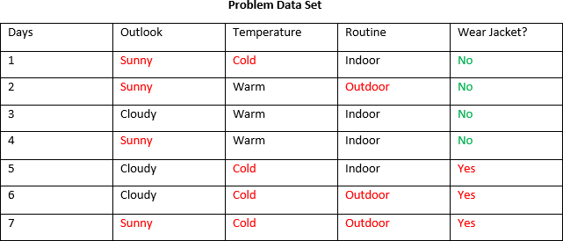
All about Decision Tree
Class

Slide 19


All about Decision Tree
Required Equations

Slide 20

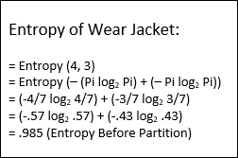
All about Decision Tree
Entropy Before Partition:
E(Y) = Entropy Before Partition E(Y|X) = Entropy After Partition Target, E(Y) >> E(Y|X)

Slide 21
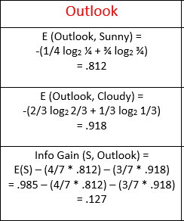
All about Decision Tree

Slide 22
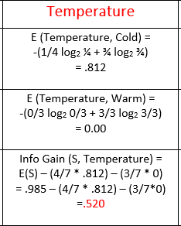
All about Decision Tree

Slide 23
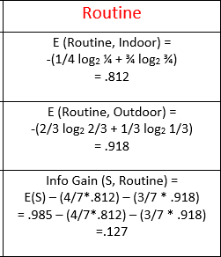
All about Decision Tree

Slide 24
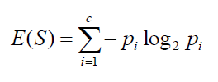
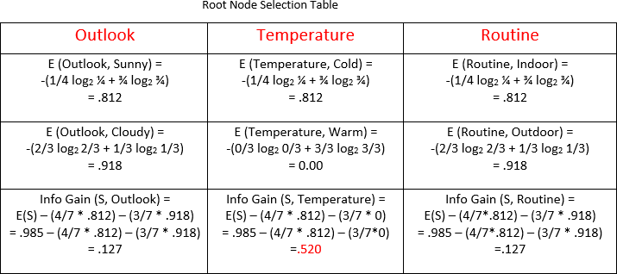
All about Decision Tree

Slide 25

All about Decision Tree
Root Node (Temperature)
Cold Yes(3), No(1)
(1,5,6,7)
Warm Yes(0), No(3)
(2,3,4)

Slide 26

All about Decision Tree
Root Node (Temperature)
Cold Yes(3), No(1)
(1,5,6,7)
Warm Yes(0), No(3)
(2,3,4)

Slide 27
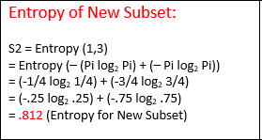
All about Decision Tree

Slide 28
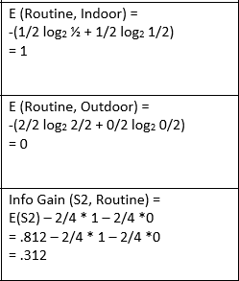
All about Decision Tree

Slide 29
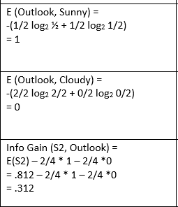
All about Decision Tree

Slide 30
All about Decision Tree
Temperature
Cold
Warm (No)
Routine
Indoor
Outdoor (Yes)
Sunny, Cold , Indoor= ??

Slide 31


All about Decision Tree
Outlook
no
yes
Sunny
Cloudy

Slide 32
All about Decision Tree
Temperature
Cold
Warm (No)
Routine
Indoor
Outdoor (Yes)
Outlook
Sunny, Cold , Indoor= ??
The Answer is ‘No’
Sunny (No)
Cloudy (Yes)

Slide 33
Random Forest
For Random Forest, Every tree will be calculated by same procedure. Final result will be generated by majority voting.
Base Learners Model
Row Sampling
Feature Sampling
Majority Voting
Data set
Row Sampling
Feature Sampling
Data set
Final Output
DT-1
DT-2
…...
DT-N

Slide 34
Random Forest
Let’s Have a Look in the Implementation with Python!

